Slide 1
Introduction to TKinter
Create your Own user interface
By
KARAN MISTRY

Slide 2
Introduction

Slide 3
In this tutorial, we will give you a brief introduction to
the subject of graphical user interface (GUI) programming.
GUI is form of user interface which allow user to interface with machine through graphical icons and audio indicator as primary notification.
The primary GUI toolkit we will be using Tk. We’ll access Tk from its Python interface called Tkinter (short for “Tk interface”).

Slide 4
Agenda
04
Labels and Text
Here is all type of widgets(operator) that we can apply to develop a GUI
05
Entry
01
Canvas
06
List box
Buttons
Check button
Menu button
Radio button
02
07
Scrollbar and Scale
03
TK.Message notification
08
Menu

Slide 5
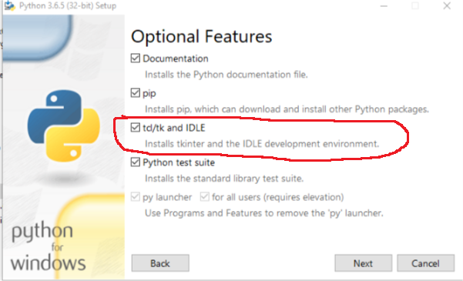
Getting Tkinter Installed and Working
To install Tkinter go to,
COMMAND PROMPT >> write command pip install python-tk
Or install directly at time of installing of python,
Whether Tkinter is available for your Python interpreter by attempting to import the Tkinter module (in Python 1 and 2; renamed to tkinter in Python 3). If Tkinter is available, then no errors occur, as demonstrated in the following:
>>> import tkinter
>>>

Slide 6
Getting Tkinter Installed and Working on the Rpi
Type the following line into a terminal window:
• sudo apt-get install python-tk
Open a Python Shell:
idle3 or Thonny
• Import the Tkinter module:
>>> import tkinter

Slide 7
Geometry Managers
Tk has three geometry managers that help with positioning your widget set:
• Placer: You provide the size of the widgets and locations to place them; the manager then places them for you. The problem is that you have to do this with all the widgets, burdening the developer with coding that should otherwise take place automatically.
• Packer: it packs widgets into the correct places (namely the containing parent widgets, based on your instruction), and for every succeeding widget, it looks for any remaining “real estate” into which to pack the next one.
• Grid: It is used to specify GUI widget placement, based on grid coordinates. The Grid will render each object in the GUI in their grid position.
• We will stick with the Packer.

Slide 8
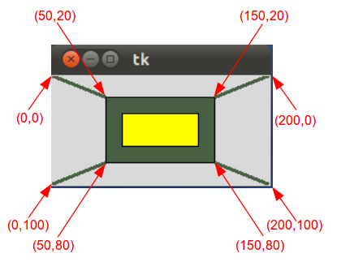
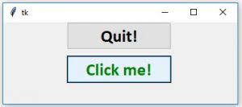
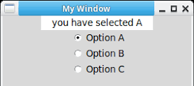
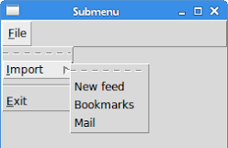
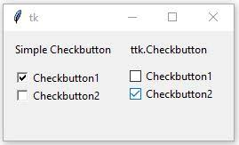
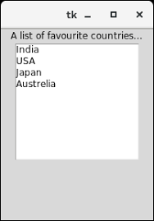
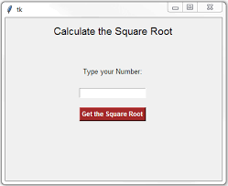
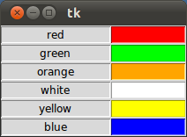
Button
Radio Button
Canvas in tkinter
Menu Button
Check Button
Entry box
Labels
List

Slide 9
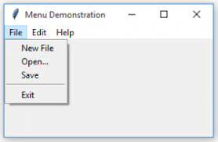
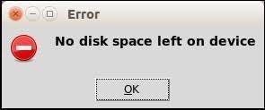
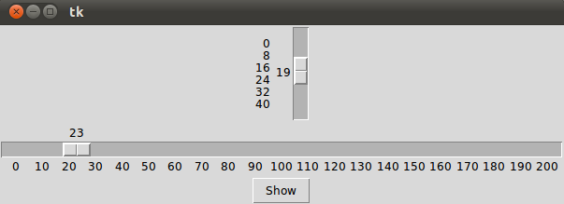
Tk.Message box
Menu
Scrollbar and scale

